Slide 1
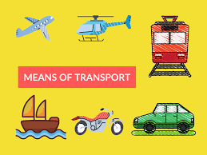

Slide 2


CAR

Slide 3

BUS

Slide 4

BICYCLE / BIKE

Slide 5


PLANE / AIRPLANE

Slide 6
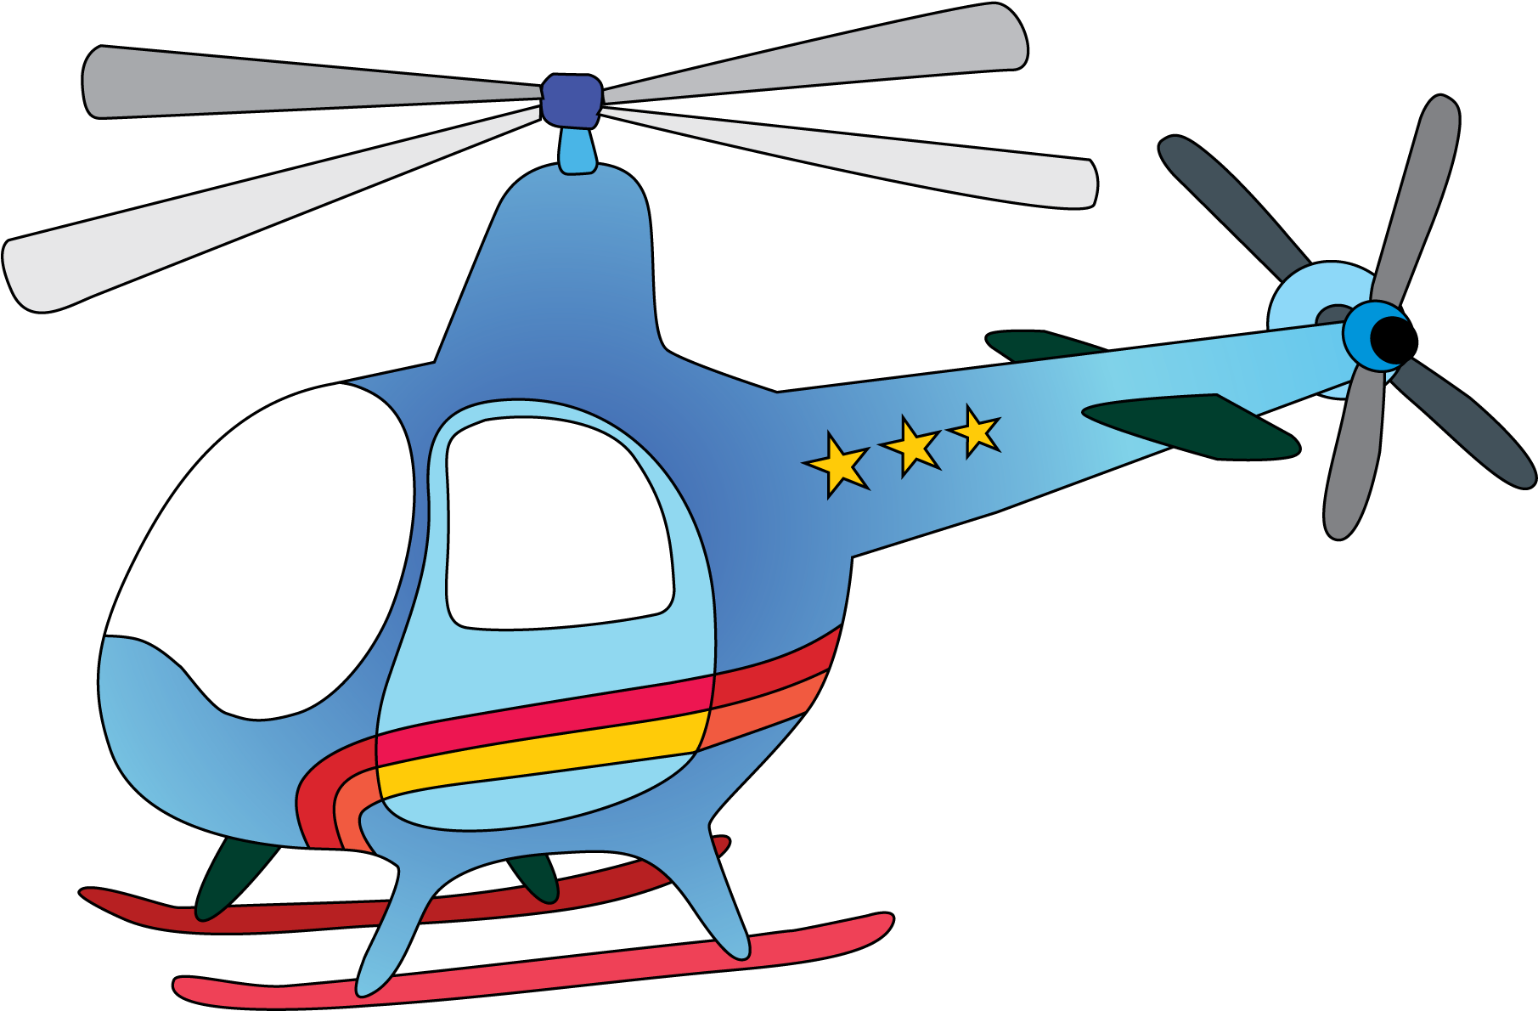
HELICOPTER

Slide 7

POLICE CAR

Slide 8

AMBULANCE

Slide 9

ROCKET

Slide 10


SHIP

Slide 11
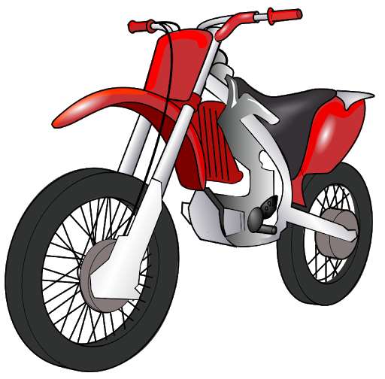
MOTORBIKE / MOTORCYCLE

